Slide 1
html tags
MCNDHS
Ms. Eng

Slide 2
aim: how do we create tables in html?
Do now:
Daily Grade:
On-time/attendance/not leaving the classroom: 25%
Cellphones: 25%
Notes:25%
Classwork/Homework: 25%

Slide 3
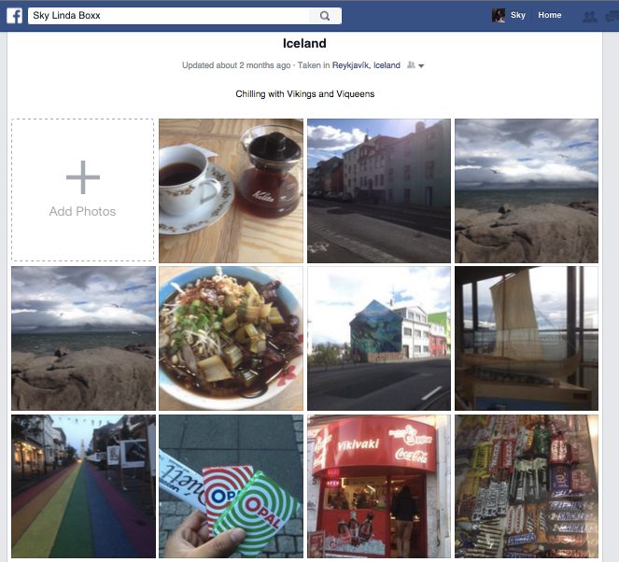
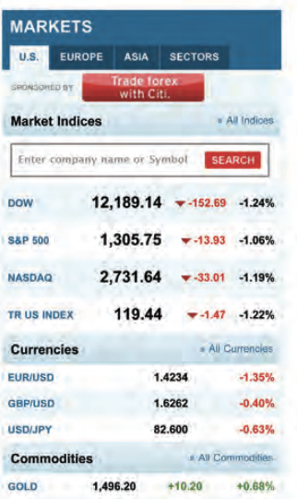
where you see it

Slide 4

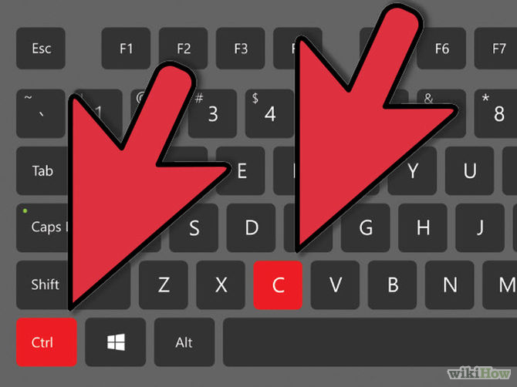
keyboard shortcuts
Shortcuts on a keyboard makes working faster!

Slide 5
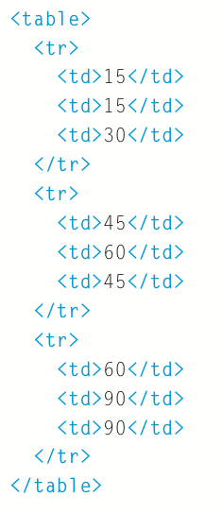
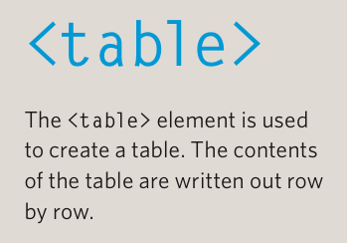

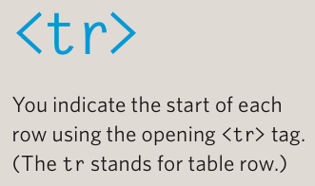
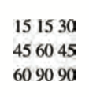

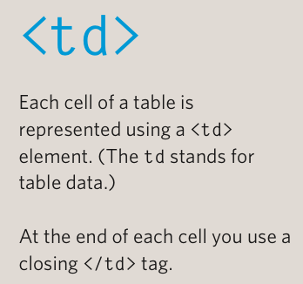

components of a table

Slide 6
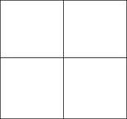
with images:
<table>
<tr>
<td>
<img src=“ “ alt=“ “ height=“ “ width=“ “>
</td>
<td>
<img src=“ “ alt=“ “ height=“ “ width=“ “>
</td>
</tr>
<tr>
<td>
<img src=“ “ alt=“ “ height=“ “ width=“ “>
</td>
<td>
<img src=“ “ alt=“ “ height=“ “ width=“ “>
</td>
</tr>
</table>

Slide 7
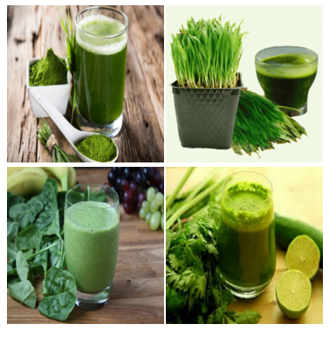
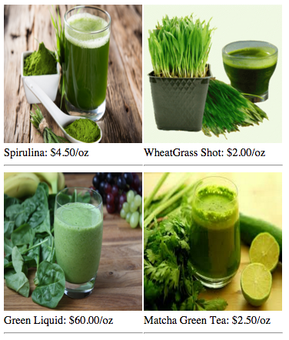
activity
Create this: Challenge:

